Slide 1
WELCOME TO THE EE LAB!
The cooler lab :)

Slide 2
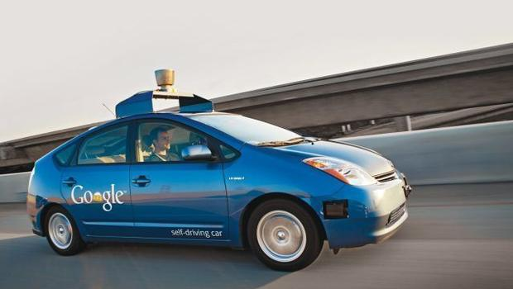
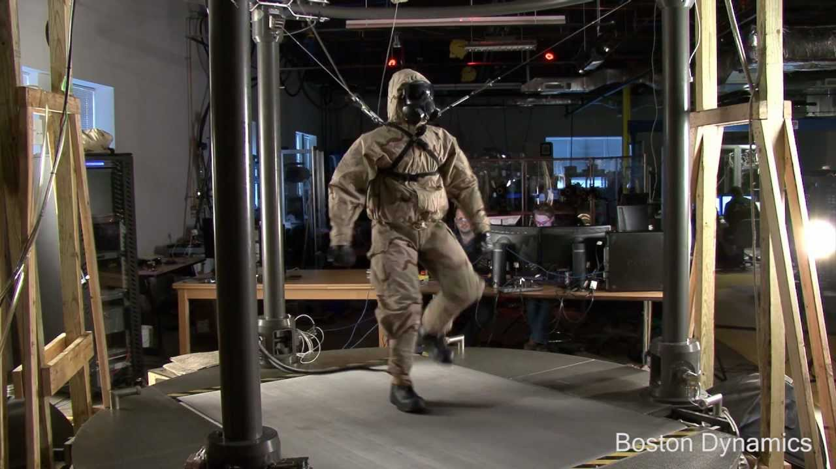
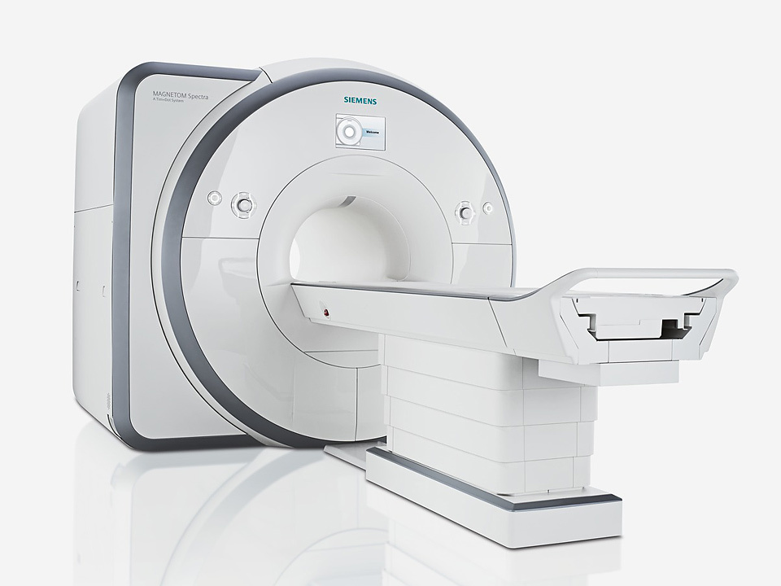
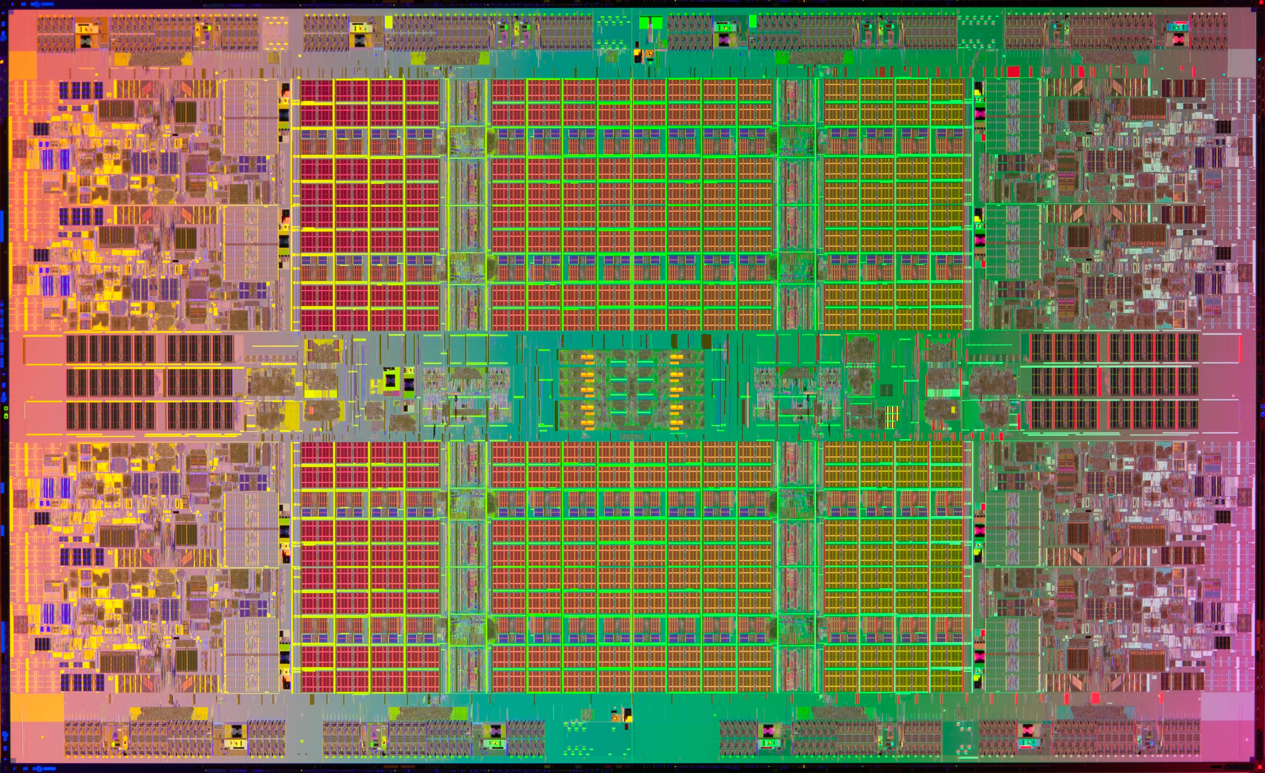

Electrical Engineering?
EE is not all Circuits! There is a massive variety of topics in Electrical Engineering
Signals and signal processing
Controls and instrumentation
Optimization models
Devices and Sensors
And of course, Circuits!

Slide 3
The Labs
Debugging Tips:
Lab 1: When programming your pin values, “LOW” and “HIGH” are keywords you can use in Energia
If running the solution file, make sure to uncomment all the code
To uncomment code remove the two “/” before the code
Lab 4 has a small error in the circuit schematic. GND and the buzzer should be connected
Individual station problems: 17, 11; come ask for help for setting your pins

